Slide 1
Acknowledgement Internet Images, available in Public Domain, have been used in many Slides of this Presentation. Some of the Images have also been Modified/Superimposed. Used only for Academic Purpose/Understanding.
Lecture-4
Takeaways :
The Notion of Building Maintenance Paradigms from Data
The Need/Motivation for Math-Stat Models for Building Process Automation Tools
Review of ODEs and Need for Transforms
Review of Laplace Transforms

Slide 2

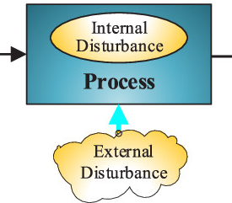
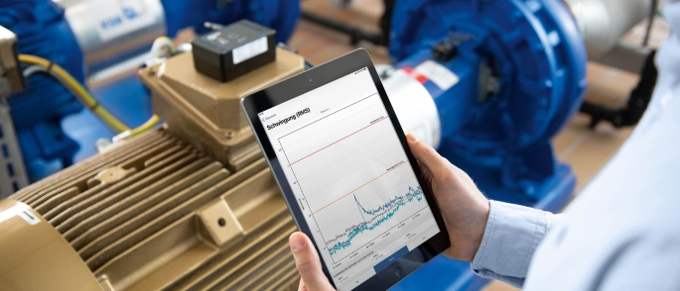
Understanding Maintenance Paradigms from Data
System
Input Variables
Parameters
Internal Variables
Measured Variables
Disturbances
Output Variables
Objectives
U-1
U-2
:
:
U-n
Y-1
Y-2
:
:
Y-m
Availability
Productivity
Profitability
System Behaviour
Rule-Based
Static
Dynamic
Domain Knowledge Inputs
Data Requirements, to meet the Objectives
Knowledge Inadequacies
Uncertainty
External Noise
Maintainability
Testability
Repairability
Can it be Managed with Data & Qualitative Domain Knowledge
Maintenance Methodologies/ Paradigms
Rule/Procedure Based
Reliability Models
Static Simulation of SSE
Dynamic Simulation of SSE
System/Eqpt. I/P-O/P Relationships
Qualitative Models
Governing ODEs/PDEs
Key Parameter Indictors
Use Data Processing/Analytic Tools
System Identification from Data

Slide 3
Appreciation of Model Building for Maintenance Automation
Re-structuring/ Re-configuring System Dynamics, based on New Data/Events
Prompting Human Operator on Actions to be Taken / Prompting/Initiating Maint. Action
Sequential Stat., Inferential Stat., Multiple Model, GLR, etc.
Data Analytics of Healthy & Faulty Data, Big Data
Fault Detection & Diagnosis Models, Sequential /Inferential Statistics
Kalman Filters & Particle Filter Intro.
Linear /Non-Linear Estimation Models, Bayesian Estimation Paradigms,
Missing Data Handling, Monte-Carlo Simulations
Estimation, Linearization, Concepts of Monte Carlo
Multivariate Anal., Matrix Operations, Least Squares
Power Spectral Density, Statistical Distance Measures
Coupled Dynamics with System Interactions, Hardware in Loop Simulations,
Multi-Input-Multi-Output Systems, Complex Dynamical Systems
Uncertainties/Noise, Stat. Mdls. & Linear Comb. with SSE Models
ODEs/PDEs, Laplace Transforms., Z-Transforms, Freq. Domain Anal.
Dynamic Simulation Models, of Individual Systems & Components for
Continuous Variable Systems (Time-Driven) & Discrete Event Systems (Event Driven)
Procedures, from CMMS, PM Schedules from Test Data
Failure Mdls./Reliability Mdls., Fault-Tree, Accelerated Test Data
Boolean Models, RTOS Mtrg.
Procedures, Maint. Plans, Look-up Tables, Data-structures, Logical Test Models, Logic Analyser Outputs
Mechanical/ Structures, Piping, Roto-Dynamic Eqpt., DGs, Process Eqpt. Mech. Handling Eqpt.
Electrical/ Power Supplies/VFDs, Power Devices, DGs, etc.
Instrumentation/ Process Sensors, Mech, Pneumatic, Chemical-Electro-Chemical & Domain-specific Inst.
Computer based Systems, Embedded Real-time Sys. & OS, DAC, Historians, Alarm-Trip Annunciations;
The Industrial Landscape
Computerized Maintenance Management System (CMMS)

Slide 4
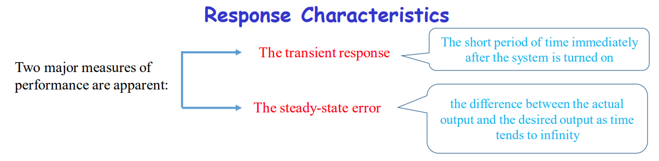
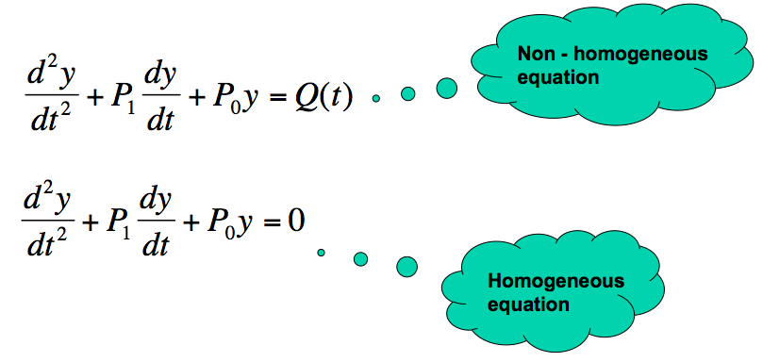
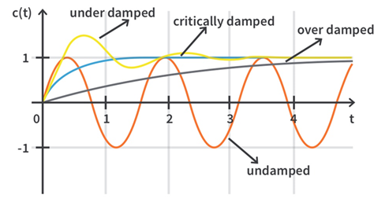
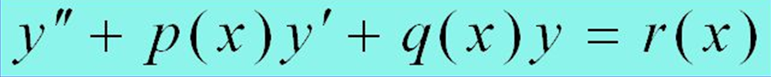
The ODE for understanding the Transient & Steady State Characteristics of a Dynamic System
Discussions with the class on Basic Derivative & Integral Terms for Dynamical Systems

Slide 5
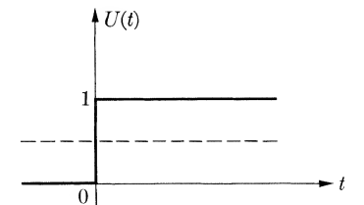
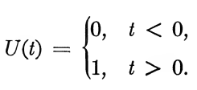
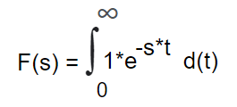
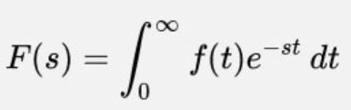

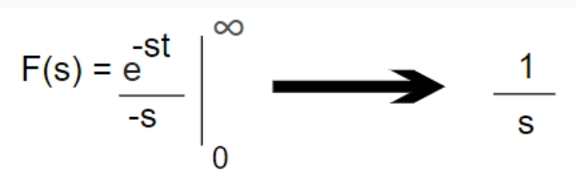

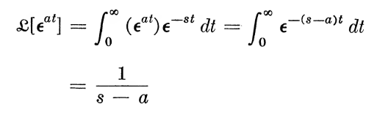
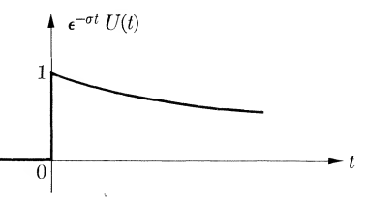
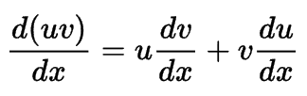
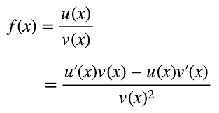

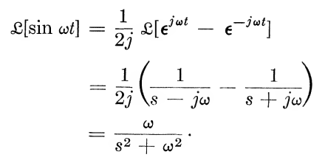
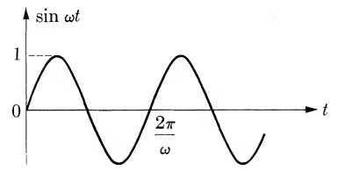

The need for Transforms
Laplace Transform
Simplifies Operations
Simplifies Functions
Converts Integro-differential Equations to
Algebraic Forms
Effectively makes use of step and impulse responses

Slide 6
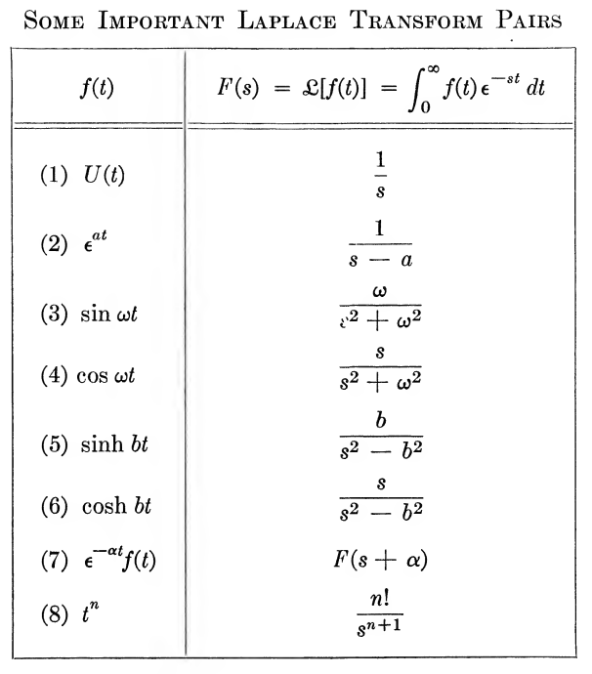
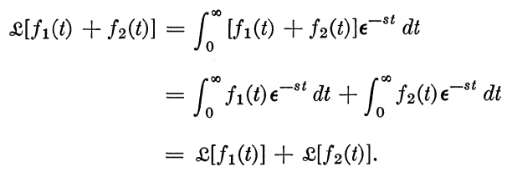
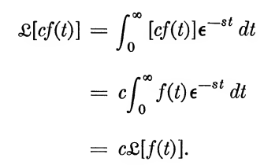

Important Properties of Laplace Transforms

